Slide 1
LING 573 Project
Charlie Guo
Emma Bateman
John Dodson
qcg@uw.edu
ebateman@uw.edu
jrdodson@uw.edu

Slide 2

Overview
Baseline extractive system
Graph-banked sentence ranking
Sentences output in order of saliency

Slide 3
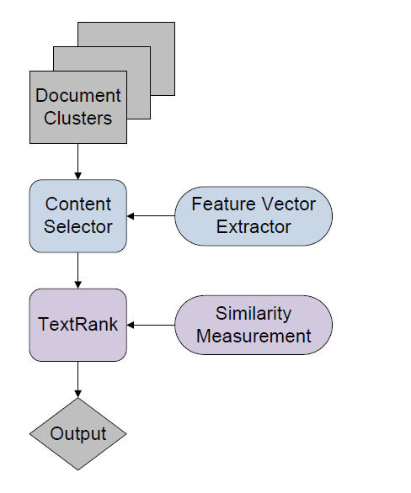
System Architecture

Slide 4
Approach

Slide 5
Content Selection
Sentence saliency estimated with graph-based algorithm
Sentences converted to unigram feature vectors
Ranked from highest to lowest relevance
Sentences selected until word count is met

Slide 6
Information Ordering
Selected in order of rank
More advanced information ordering to come

Slide 7
Content Realization
Sentences corresponding to selected feature vectors written to text file

Slide 8
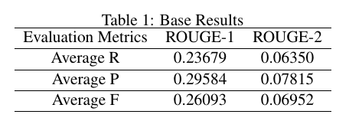
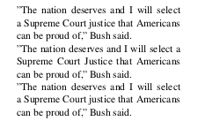
Notable Errors:
Coherence
Missing antecedents
Fragments of quotations
Redundancy
Repetition of key ideas
Identical or very similar sentences
Results

Slide 9
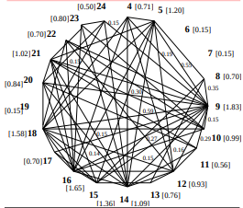
Related Reading: TextRank
Mihalcea & Tarau, University of North Texas

Slide 10
Thank you.

